Slide 1


LEARNING OBJECTIVES: TEMPLATE

Slide 2

About this template
This template is designed to help course developers write SMART learning objectives. This is the starting point of an effective eLearning course design. Setting clear objectives since the beginning will guide and organize the work for both you and the learner. Skipping this important step can lead to pointless courses serving merely as a waste of time.

Slide 3
STEP 1: Course description
Use these lines to briefly explain the course’s big picture. What’s it about?
…

Slide 4
STEP 2: Define course goals
Define at least 3 course goals. They should be broad and general.
1.
2.
3.

Slide 5

STEP 3: Write learning objectives
Learning objectives describe what the learners will be able to DO upon completion of the eLearning course. Before writing learning objectives, make sure you understand the basics.
Learning Objectives should be S.M.A.R.T:
Specific: Make learning objectives as specific, focused, and clear as possible – general outcomes will be hard to measure! They should indicate a clear action.
Measurable or observable: Learning objectives should be written in terms of observable, behavioral outcomes. Include features that will help you know whether the objective has been achieved.
Achievable: Make sure they are achievable within the time-span of the eLearning course.
Realistic: Should be supported by the appropriate tools and resources.
Time-bound: They should specify a timeframe for action.

Slide 6
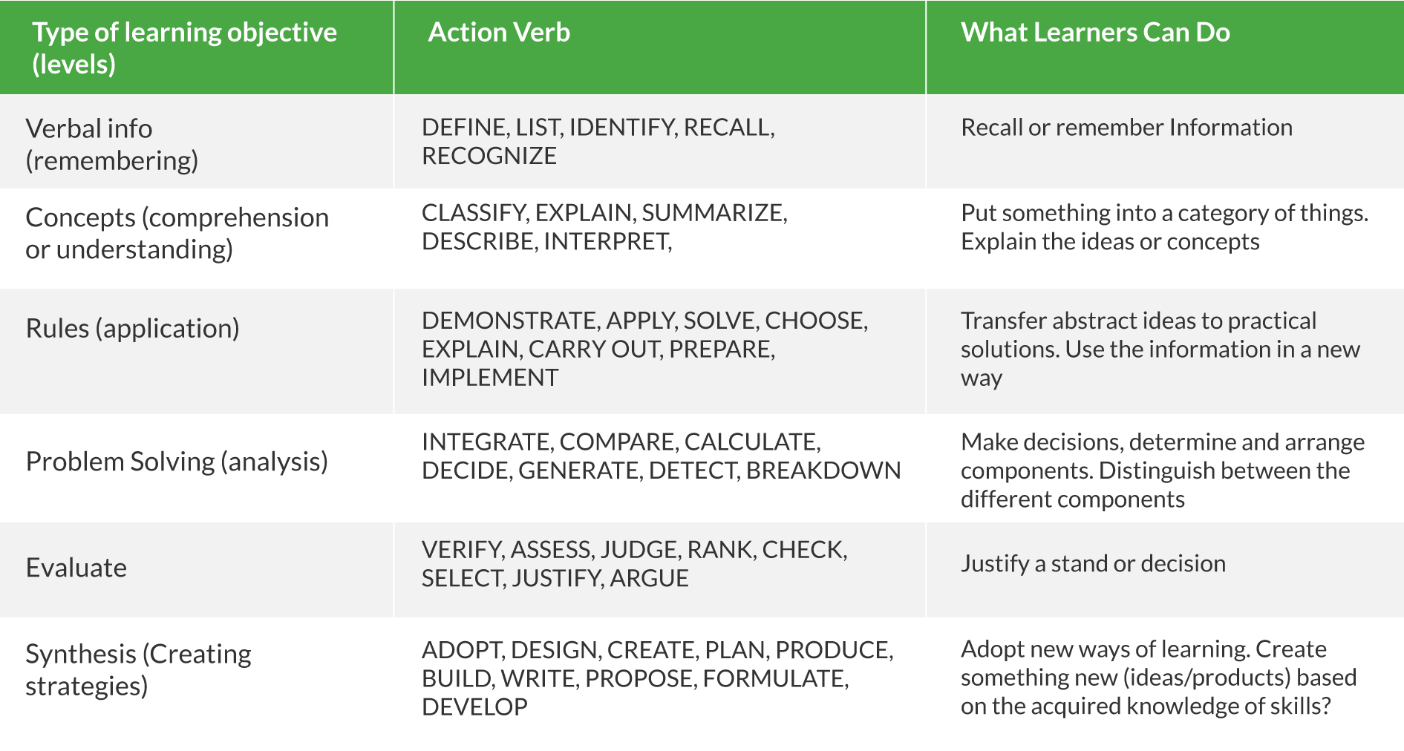
Use Bloom's Taxonomy to Write Objectives
Use the table below to help you select the level of the learning outcomes you want to achieve, using an action verb.

Slide 7
IMPORTANT NOTES:
* Most of the time, a course requires a mix of levels depending on what you want to achieve.
* Verbs to Avoid When Writing Learning Objective: Know, Learn, Become, Understand, Appreciate, Improve, Grow
* Use only one action verb per outcome.

Slide 8
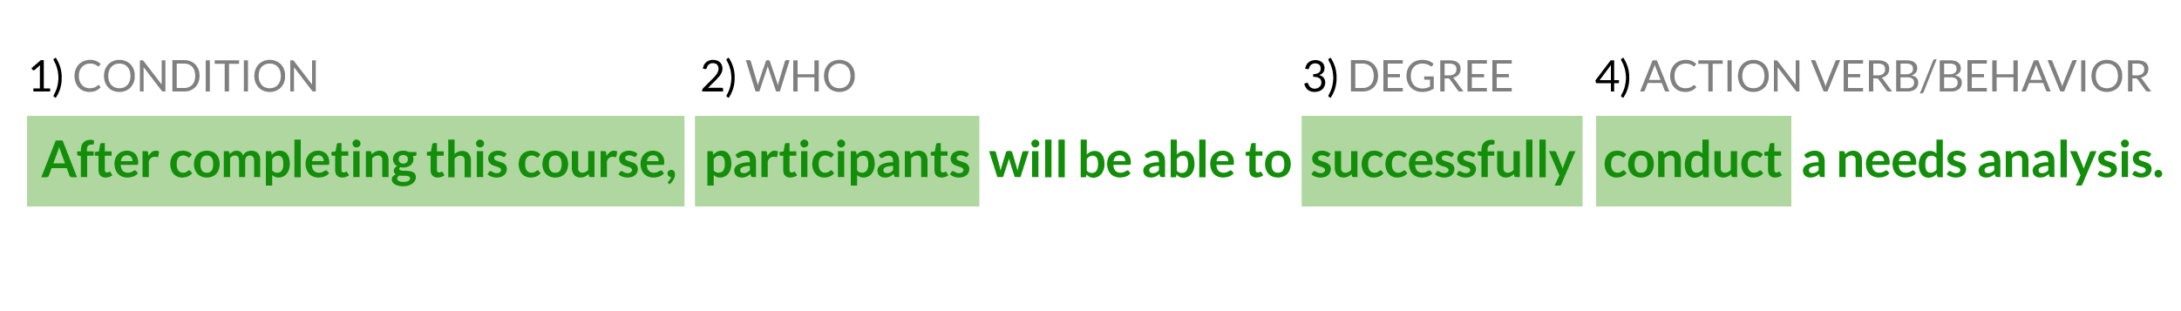
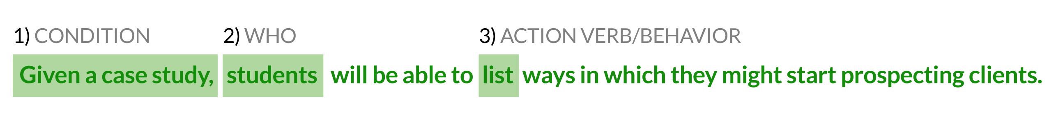
An Objective Should Have 4 Components (ABCD): Audience, Behavior, Condition, and Degree.
* Degree (how well the learner must perform) can be omitted if desired.
Sometimes it is implied when words such as correctly and successfully are used.

Slide 9
Now it’s your turn!
Write learning objectives:
1.
2.
3.
Note: Write as many learning objectives as required. There should be as many objectives as needed to determine what the learners will gain from your course.

Slide 10
STEP 4: Align Learning Objectives with Assessments and Activities
Learning objectives should clearly align with:
(1) Learning activities (these activities help students achieve the objectives) and
(2) Assessments (to keep track of the learner’s performance).
Notes:
* It is best if learning activities/assessments and corresponding objectives are at the same level in Bloom’s taxonomy.
* Include only those activities and assessments that help you achieve the learning objectives.

Slide 11
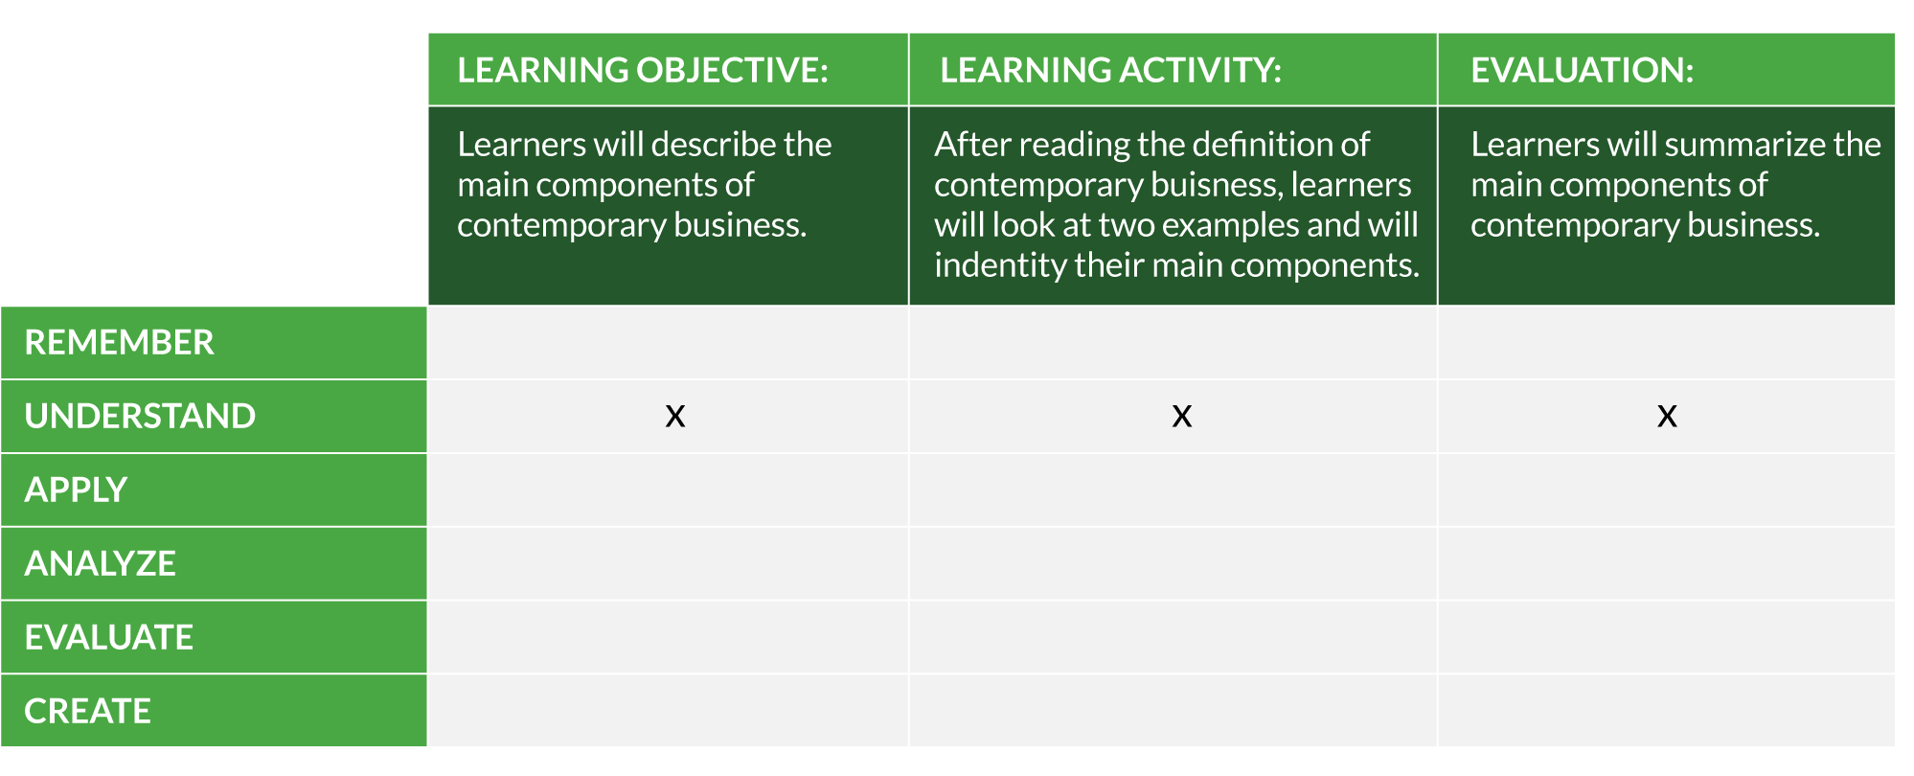
For example, if the learning objective is to “…describe the main components of contemporary business,” the course designer should develop activities and evaluations to encourage practice and assess the learners’ level of comprehension on the subject, as shown in the table below:
Table reference: E-learning methodologies. A Guide for Designing and developing e-Learning courses.

Slide 12
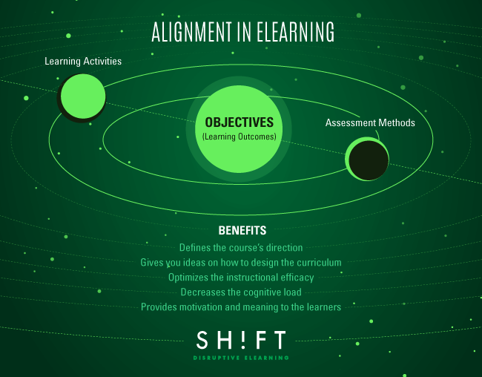

Slide 13
THANK YOU!

Slide 14
Consulted sources:
http://www.slideshare.net/satishverma66/e-learninghow-to-develop-elearning-from-start-to-end
http://ce.uwex.edu/wp-content/uploads/2015/02/LearningObjectives.pdf

